Slide 2
Automotive Mechatronics Laboratory
Topic:
DS1104
Weekly Report
Presenter : - Nguyen Trung Hoa
2024-12-16
aml.edu.vn

Slide 3
Outline
DS1104 R&D Controller Board overview
Board components
How to use
Rapid control system

Slide 4
1. ds1104 overview

Slide 5
Outline
Overview

Slide 6
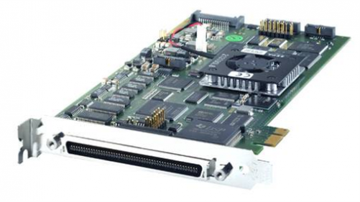
1.1. Overview
The DS1104 R&D Controller Board is a cost-effective entry-level system with I/O interfaces and a real-time processor on a single board
It can be plugged directly into and upgrades your PC to a development tool for rapid control prototyping, education purposes, …
The DS1104 is specifically designed for high-speed multivariable digital controllers and real-time simulations

Slide 7
1.1. Overview
The DS1104 can be plugged into a PCI/PCIe slot of a PC.
It is a complete real-time control system based on a 603 PowerPC floating-point processor running at 250 MHz
For advanced I/O purposes, the board includes a slave-DSP subsystem based on the TMS320F240 DSP microcontroller.
It has 100-pin I/O connector on the board for analog, digital signals, PWM, … easily connect with sensors and actuators

Slide 8
2. Board components

Slide 9
Outline
Board components overview
Block diagram of DS1104

Slide 10
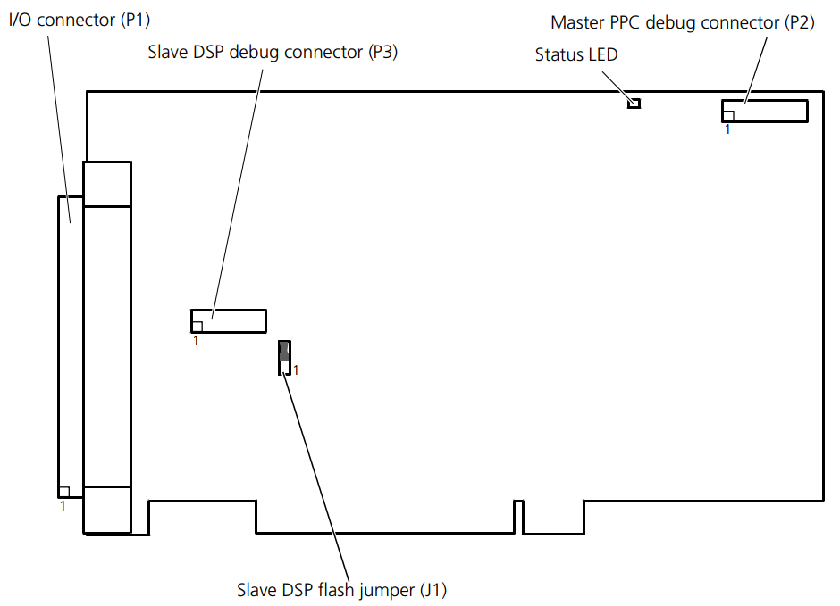
2.1. Board overview
The DS1104 contain important elements

Slide 11
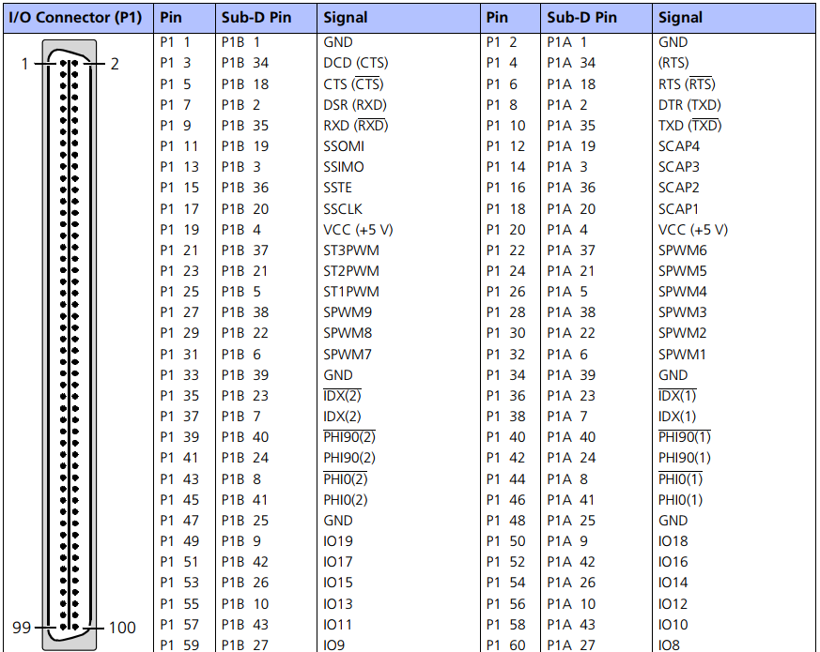
2.1. Board overview
The I/O connector (P1) is a 100-pin connector. The signals available at this connector are described in I/O Connector (P1)

Slide 12
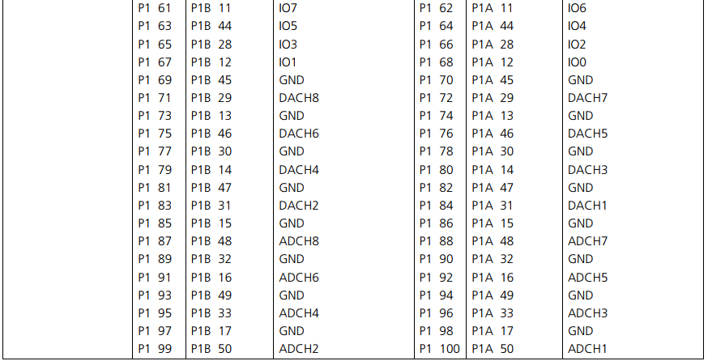
2.1. Board overview
The I/O connector is a 100-pin connector

Slide 13
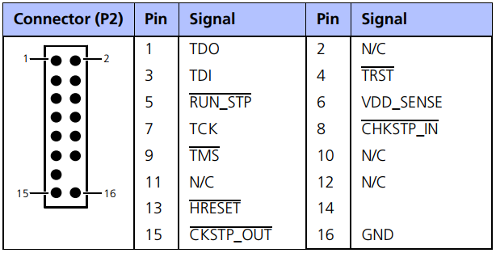
2.1. Board overview
The master PPC debug connector is a JTAG 1149.1 hardware debug connector and can be used for master PPC debugging

Slide 14
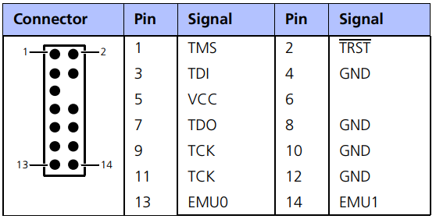
2.1. Board overview
The slave DSP debug connector is a JTAG 1149.1 hardware debug connector and can be used for slave DSP debugging

Slide 15
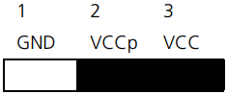
2.1. Board overview
The slave DSP flash jumper is used to control the protection mode of the flash memory and the watchdog mode

Slide 16
2.1. Board overview
The red status LED is equipped for troubleshooting purposes
If the LED is lit, the host PC’s PCI bus for the DS1104 is over or underclocked. The LED is lit whenever the clock rate is lower than 5 MHz or higher than 35 MHz (For PCI interfaces, 33 MHz is the standard frequency)

Slide 17
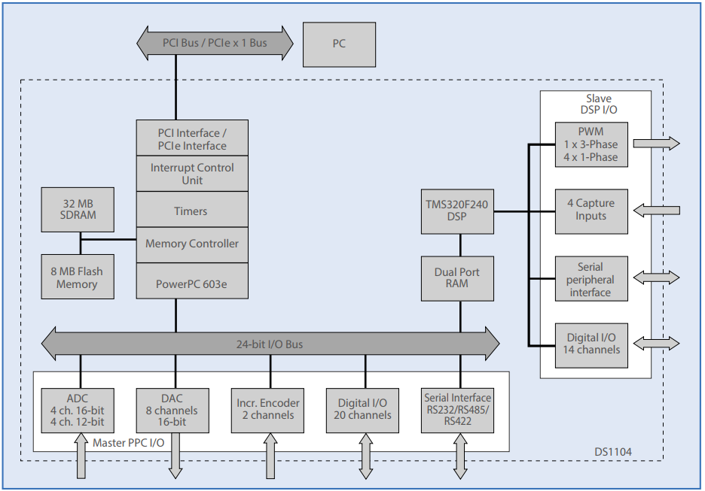
2.2. Block diagram

Slide 18
3. How to use

Slide 19
Outline
Real-Time Interface (RTI)
Control Desk
Set up

Slide 20
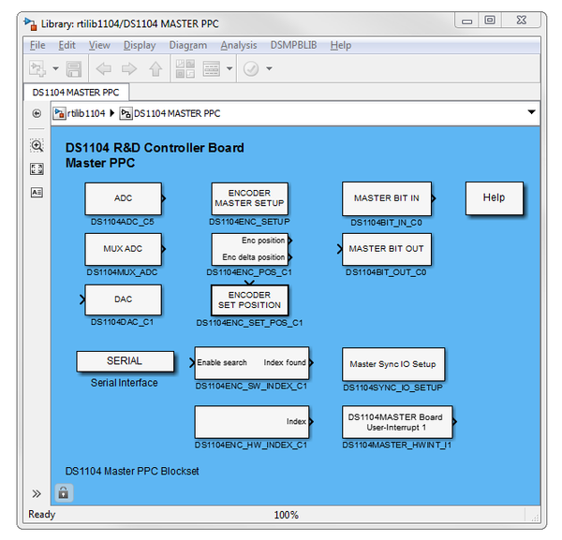
3.1. Real-Time Interface (RTI)
It is a software integrates dSPACE blocks for control models developed in MATLAB/Simulink for hardwares of Dspace like DS1104.
RTI enable user to transfer Simulink models to C code, compiled and loaded to hardware for control and adjust in real-time

Slide 21
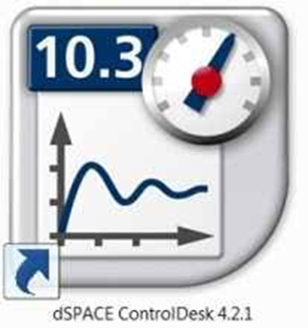
3.2. Control Desk
It is a GUI for development, test control models in real-time for dSPACE hardware like DS1104, tune control algorithms
Real-time data monitoring
User Interface Customization
Parameter Tuning

Slide 22
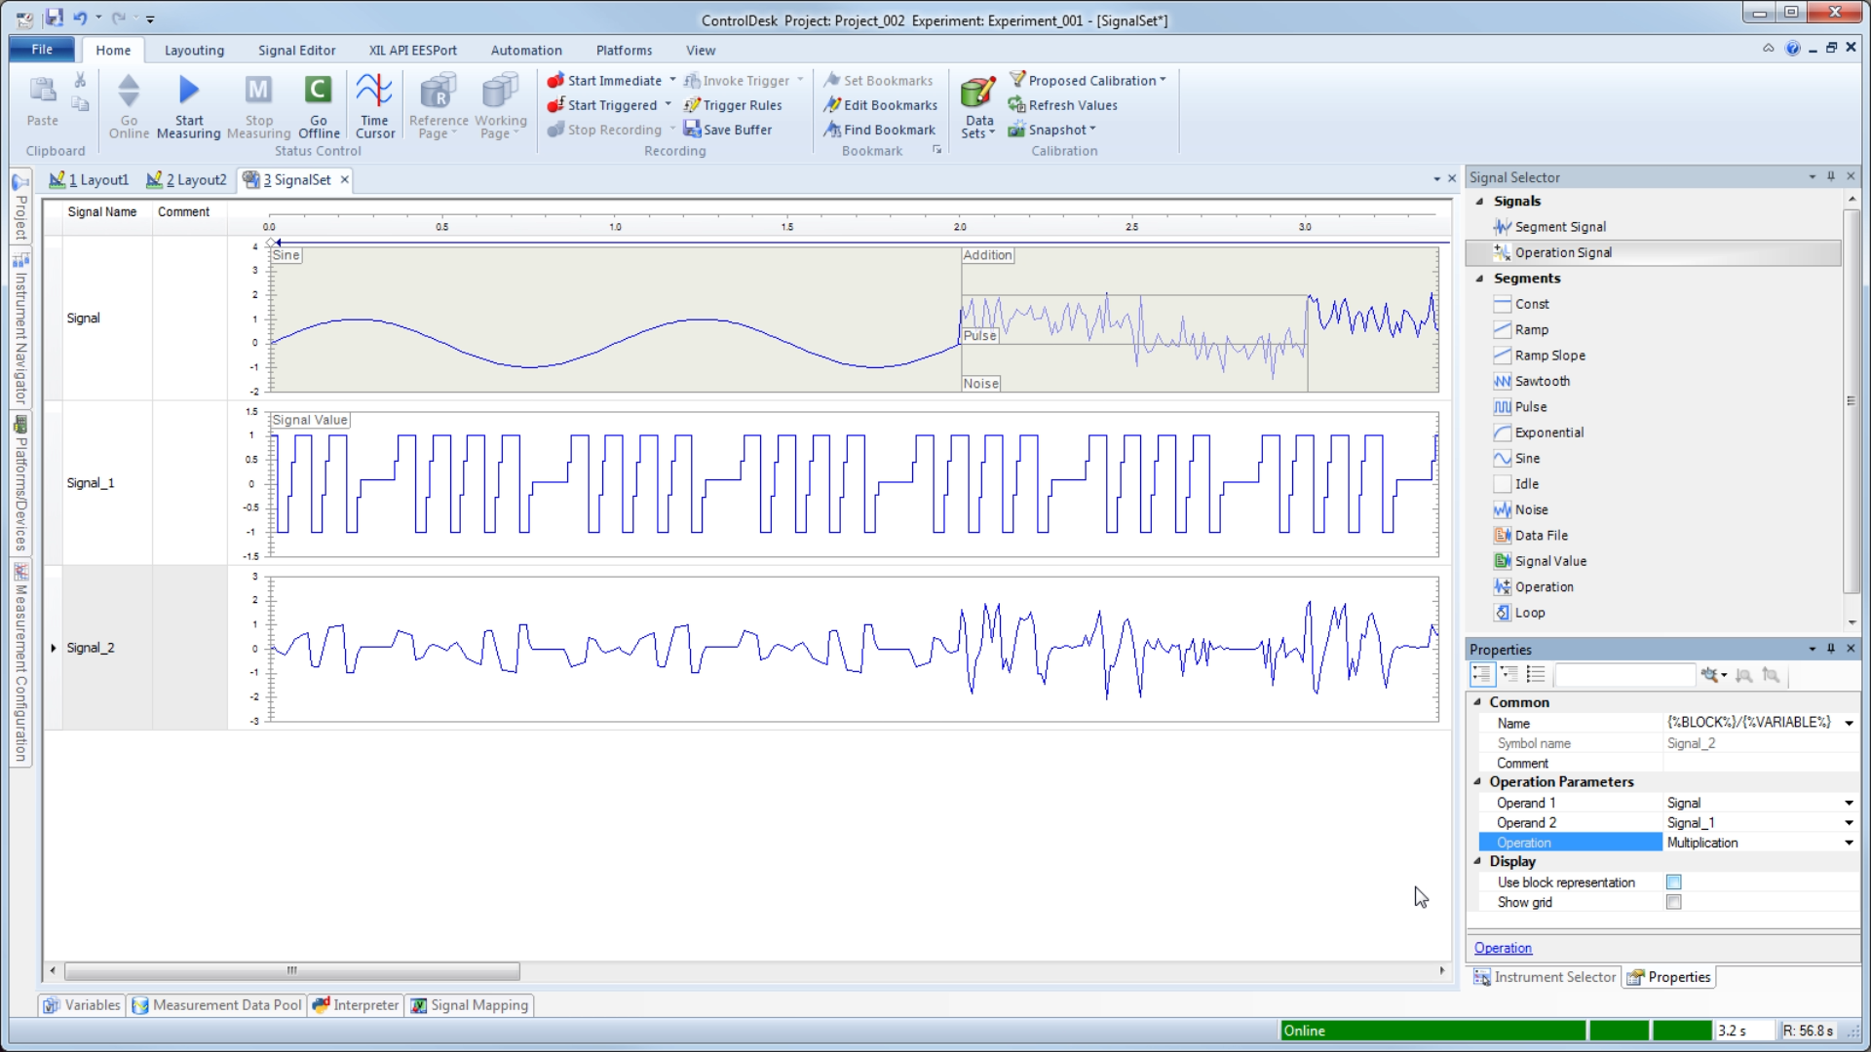
3.2. Control Desk
Control Desk interface

Slide 23
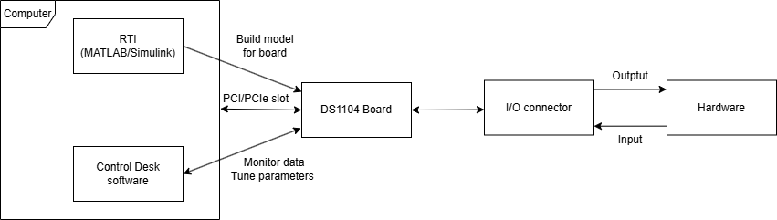
3.3. Set up
Connect DS1104 board with hardware to control via I/O connector
Connect DS1104 board with computer via PCI/PCIe slot
Setup diagram for DS1104 Board

Slide 24
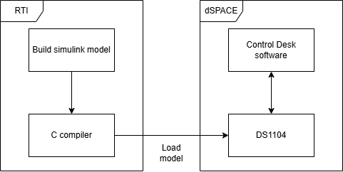
3.3. Set up
RTI (MATLAB/Simulink) build control model and load it to dSPACE hardware
Control Desk create GUI to monitor data and tune parameter in model real-time
Work flow of DS1104 Board

Slide 25
4. RAPID CONTROL SYSTEM

